Slide 1
Would you like to watch this movie?
Year: 2008
Director: Christopher Nolan
Budget: $ 185 000 000
Actors:
Christian Bale
Morgan Freeman
Heath Ledger

Slide 2
Would you like to watch this movie?
Year: 2008
Director: Christopher Nolan
Budget: $ 185 000 000
Actors:
Christian Bale
Morgan Freeman
Heath Ledger
Title: The Dark Knight

Slide 3
Would you like to watch this movie?
Year: 2008
Director: Christopher Nolan
Budget: $ 185 000 000
Actors:
Christian Bale
Morgan Freeman
Heath Ledger
IMDB score: 9.0/10.0
Gross Income: $ 533 316 061 (USA)
Profit: aprox. 348 000 000 (288%)
“most lucrative opening for any film”
Title: The Dark Knight

Slide 4
How about this one?
Year: 2014
Director: Jon Favreau
Budget: $ 11,000,000
Actors:
Jon Favreau
Robert Downey Jr.
Scarlett Johansson
Title: Chef

Slide 5
How about this one?
Year: 2014
Director: Jon Favreau
Budget: $ 11,000,000
Actors:
Jon Favreau
Robert Downey Jr.
Scarlett Johansson
Title: Chef
IMDB score: 7.3/10.0
Gross Income: $ 30,640,336 (USA)
Profit: aprox. $19,000,000 (272%)

Slide 6
IMDB movie rating prediction system
By Daniela Florit

Slide 7
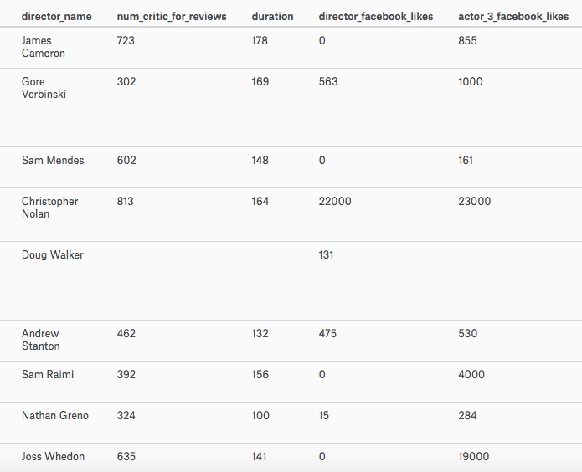
The problem
Analyzing the relations between certain features of the movie, and its popularity (IMDB rating)
Predicting IMDB rating
Dataset: Kaggle.com
5000+ movies
28 variables
100 years
66 countries

Slide 8

Previous works
Netflix
It’s focused on personalizing the experience and recommending movies based on personal preferences.
This project:
Focuses on population preferences, to predict success of the film

Slide 9

Why?
Understanding the movie industry
Understanding trends in population’s preferences
Applicable to marketing
Trailer and poster creation

Slide 10
objective
Predict the rating for each movie
Compare the accuracy of two classifiers
Analyze trends:
Which features are most relevant
Predict popularity of movies coming up now
Notes:
Create a model that is able to predict what the IMDB rating for each movie will be

Slide 11
Challenges
Deciding the learning algorithm
Dataset is not complete
Choosing the appropriate features

Slide 12
The approach:
Plot data to see trends (help build an intuition)
Select the appropriate features
Logistic regression
Second classifier

Slide 13
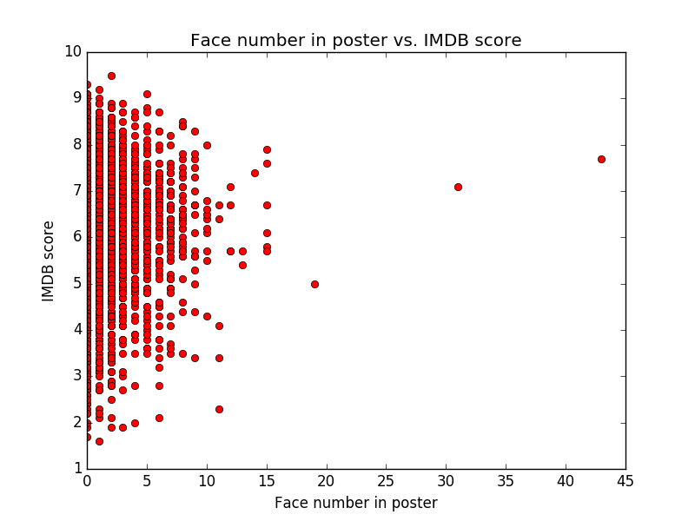
Trends:

Slide 14
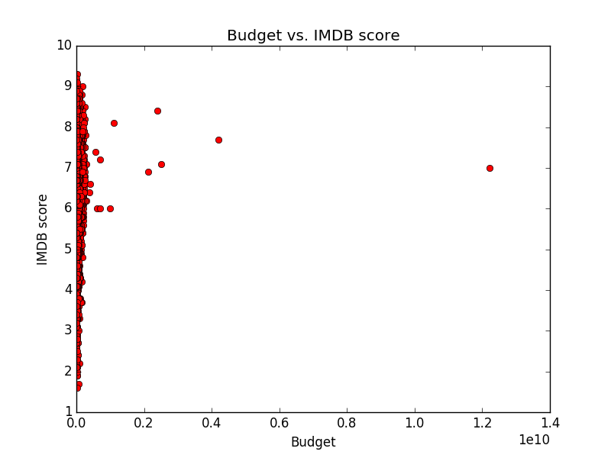
Trends:

Slide 15
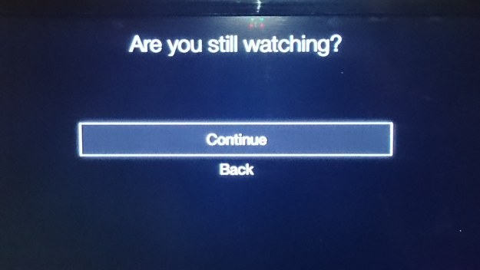
Questions??

